Slide 1
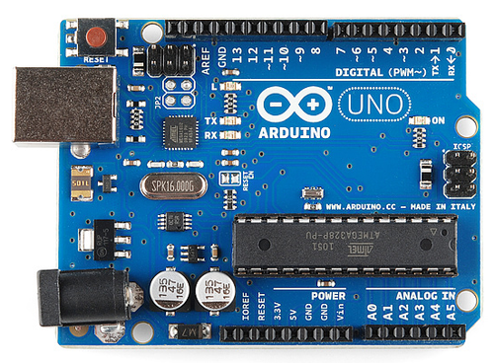
Arduino UNO Board
Did by the team CR’s :
A.ZAHEER SHA
&
ADNAN ALI

Slide 2
What is Arduino?
PART-B
EXP No: 8
Arduino is an open-source electronics platform based on easy-to-use hardware and software.
Arduino boards are able to read inputs - light on a sensor, a finger on a button, or a Twitter message - and turn it into an output - activating a motor, turning on an LED, publishing something online.
We can tell to the board what to do by sending a set of instructions to the microcontroller on the board. To do so we have to use the Arduino programming language and the Arduino Software (IDE).

Slide 3
Why Arduino?
PART-B
EXP No: 8
Simple and easy-to-use
Inexpensive
Cross-platform: The Arduino Software (IDE) runs on Windows, Macintosh OSX, and Linux operating systems
Simple, clear programming environment
Open source and extensible software
Open source and extensible hardware

Slide 4
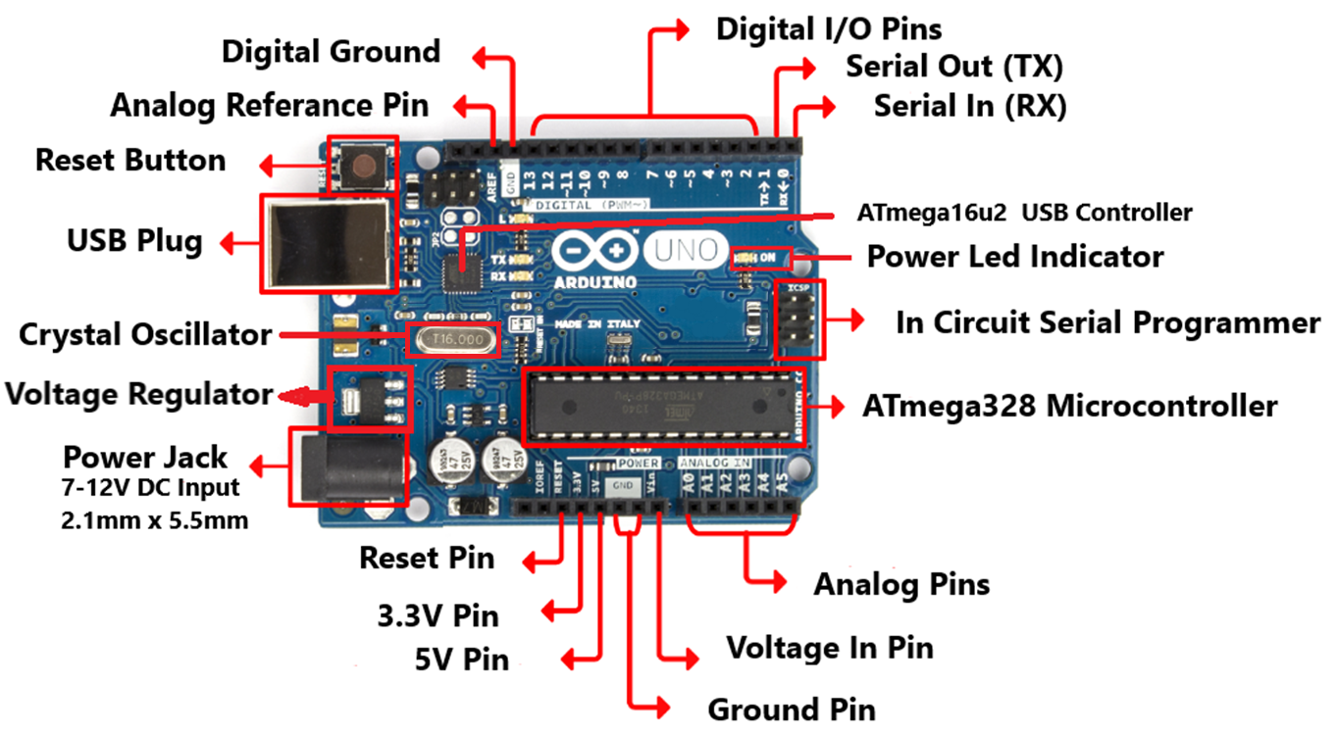
Arduino UNO Board Parts
PART-B
EXP No: 8

Slide 5
Specifications of Arduino UNO
PART-B
EXP No: 8
Microcontroller
Operating Voltage
Input Voltage (recommended)
Digital I/O Pins
Analog Input Pins
DC Current per I/O Pin
DC Current for 3.3V Pin
Flash Memory
SRAM
EEPROM
Clock Speed
LED Built In Pin
UART, SPI & I²C
Timers
: ATmega328P (8-bit)
: 5V
: 7-12V
: 14 (of which 6 provide PWM output)
: 6 (10-bit ADC Channels)
: 40 mA
: 50 mA
: 32 KB
: 2 KB
: 1 KB
: 16 MHz
: 13
: 1
: 3 (Two 8-bit / One 16-bit)

Slide 6
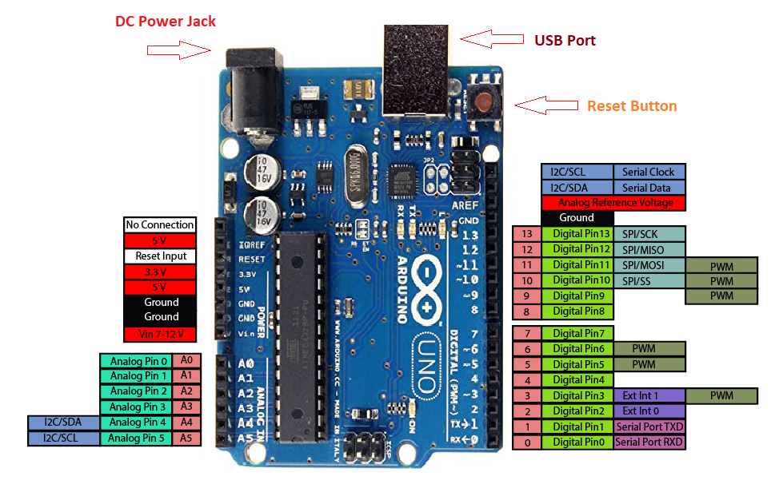
Arduino UNO Pin Out

Slide 7

Arduino IDE
PART-B
EXP No: 8
The Arduino integrated development environment (IDE) is a cross-platform application (for Windows, macOS, and Linux) that is written in the Java programming language.
It is an open-source Arduino Software (IDE) makes it easy to write code and upload it to the board. This software can be used with any Arduino board.

Slide 8
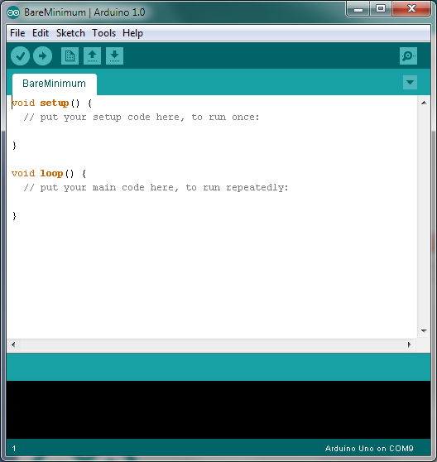
Tools of Arduino IDE
PART-B
EXP No: 8
Text editor
syntax and keyword coloring
automatic indentation
programming shortcuts
Compiler
Hardware Interface
Uploading programs
Communicating with Arduino via USB

Slide 9
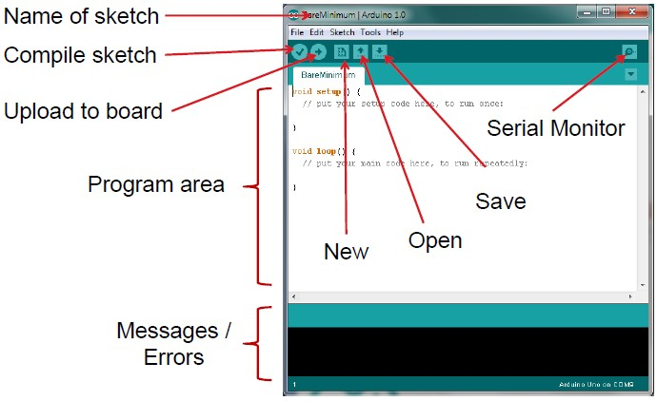
Arduino IDE Window Options
PART-B
EXP No: 8
Verify sketch
Board
Serial COM
Port

Slide 10
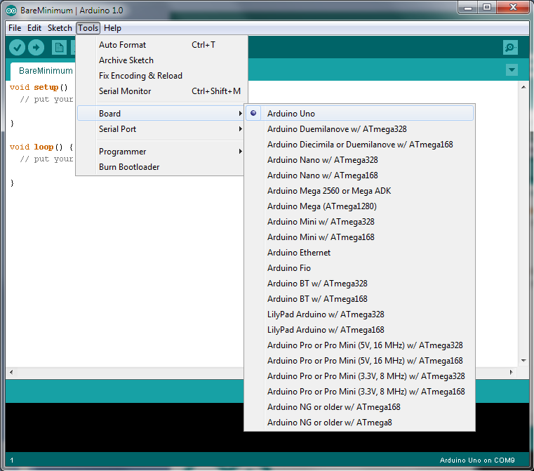
Select your Board

Slide 11
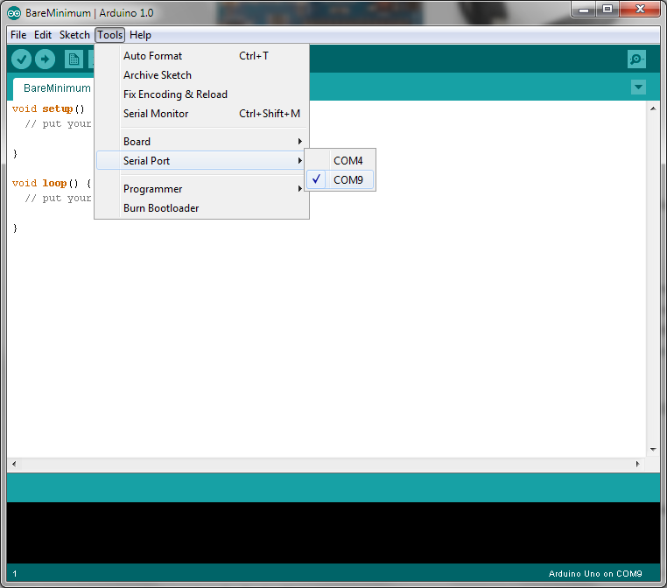
Select Serial Port

Slide 12
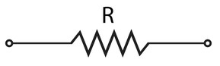
Resistor Symbol
PART-B
EXP No: 9

Slide 13
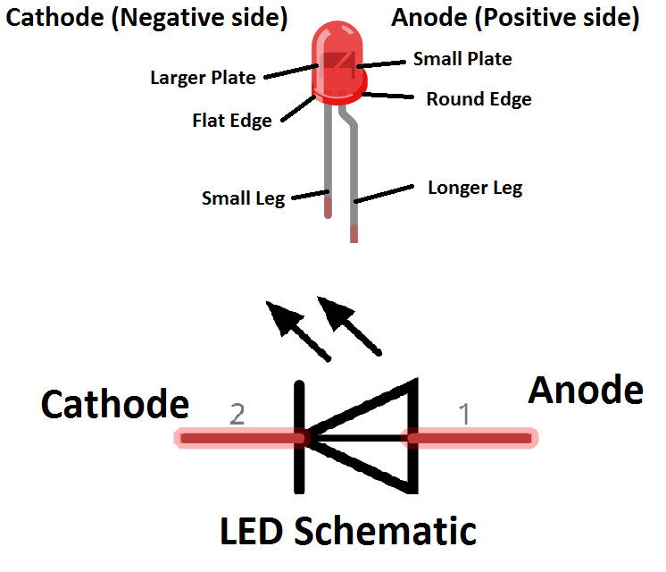
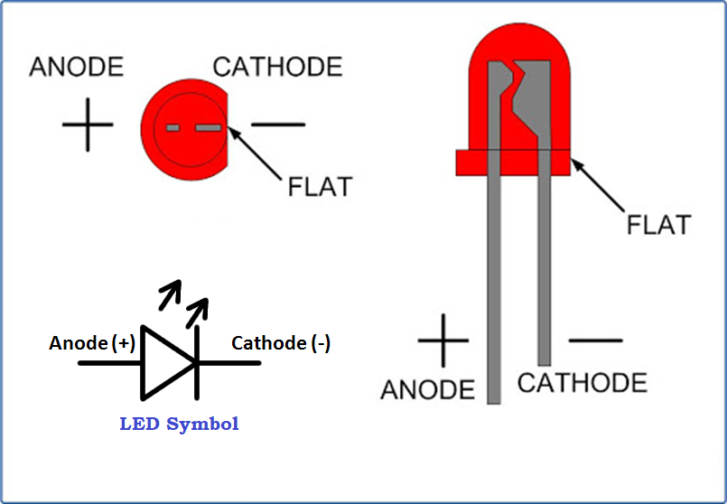
LED Symbol & Pinout
PART-B
EXP No: 9

Slide 14
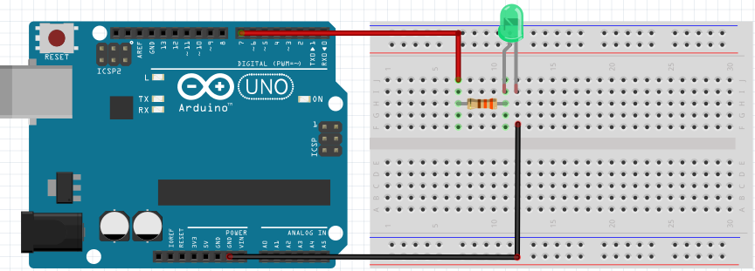
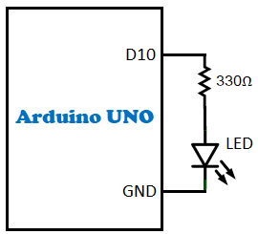
Arduino UNO & LED Connection
PART-B
EXP No: 9
Hardware Block Diagram

Slide 15
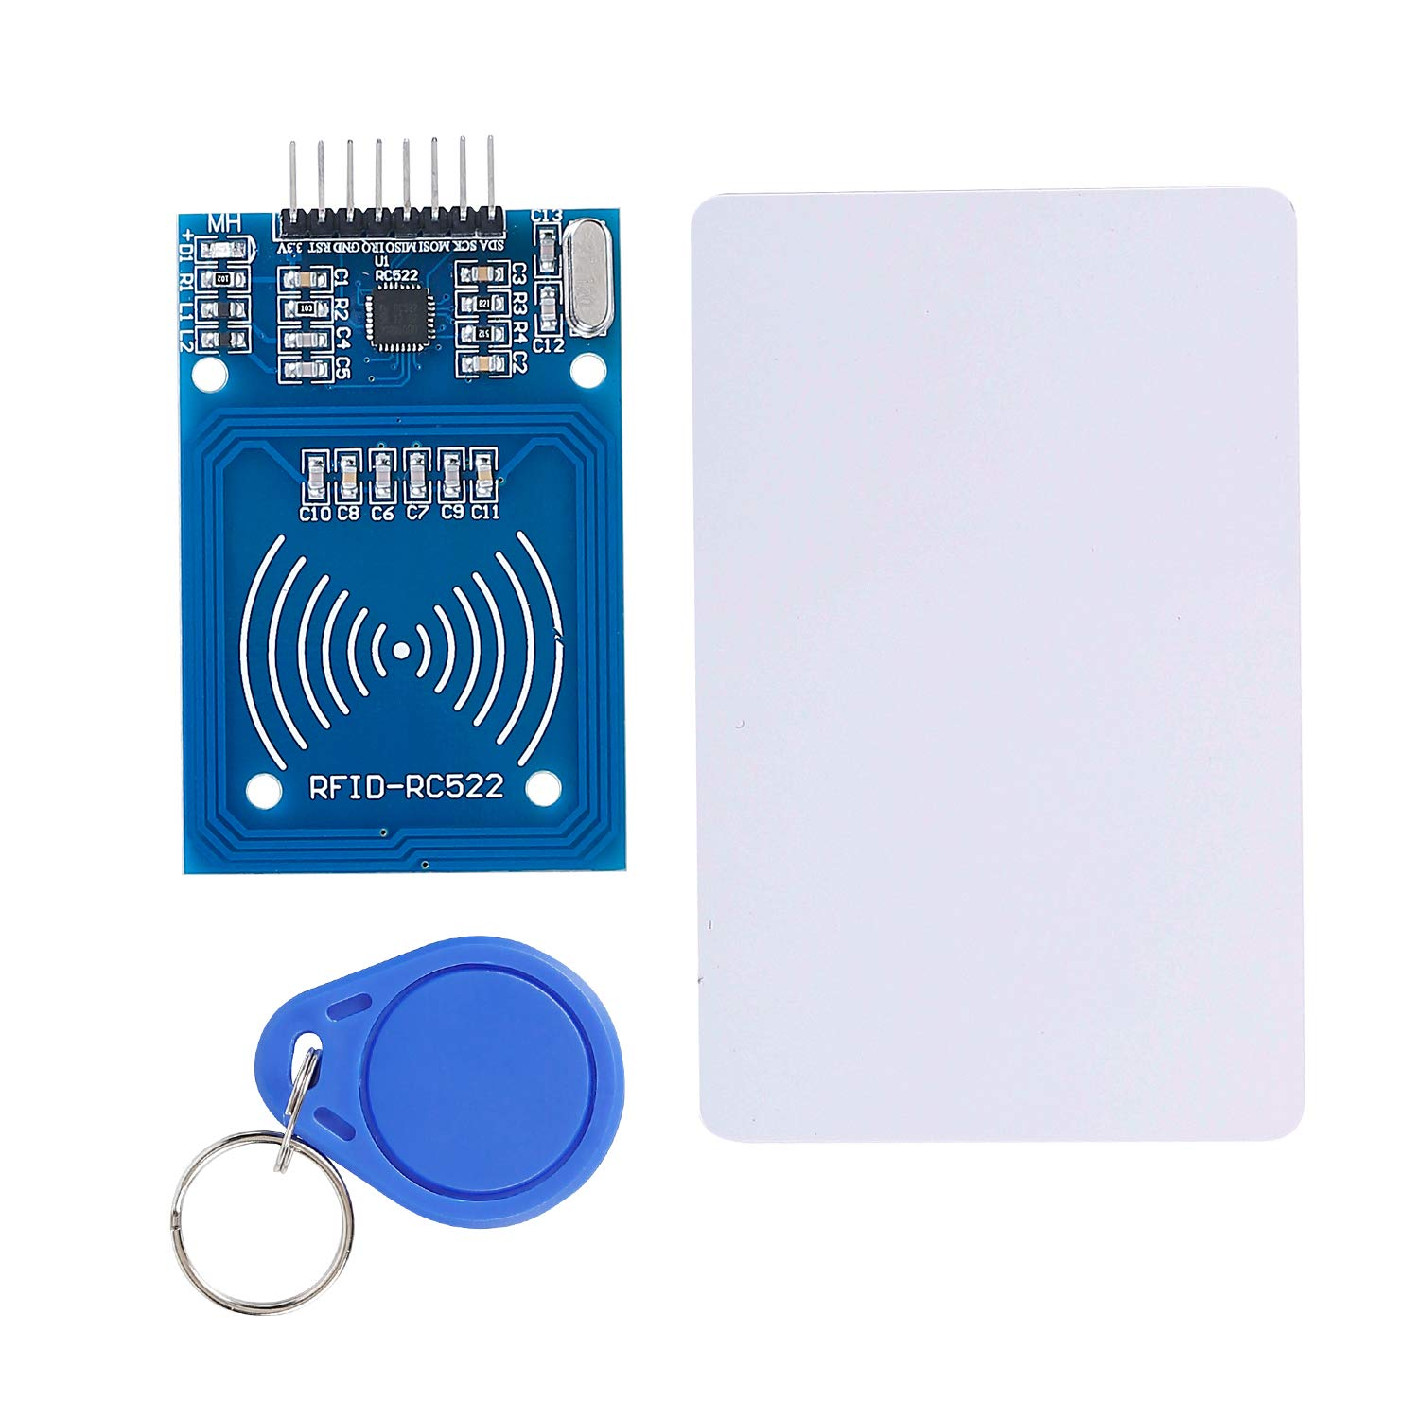
RFID READER & TAGS
PART-B
EXP No:12
RFID TAG (KEY TYPE)
RFID READER/WRITER
ANTENNA
RFID TAG (CARD TYPE)

Slide 16
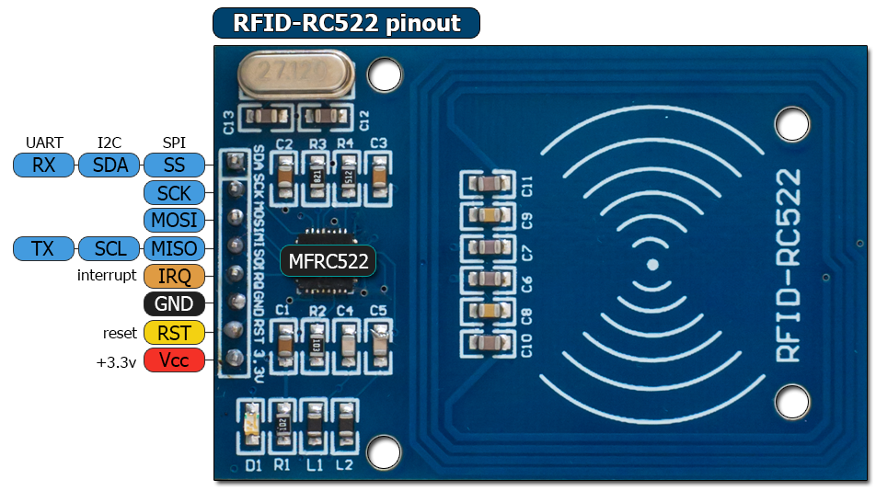
RFID RC522 Pinout
PART-B
EXP No:12

Slide 17
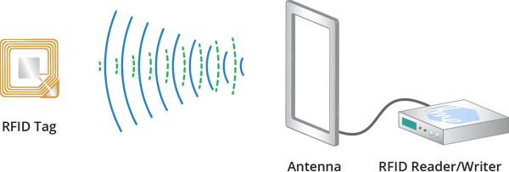
RFID technology
PART-B
EXP No:12
What is RFID technology and How does it work?

Slide 18
RFID technology
PART-B
EXP No:12
What is RFID technology and How does it work?
RFID (Radio Frequency Identification) system consists of two main components, a transponder/tag attached to an object to be identified, and a Transceiver also known as interrogator/Reader.
A Reader consists of a Radio Frequency module and an antenna which generates high frequency electromagnetic field. On the other hand, the tag is usually a passive device, meaning it doesn’t contain a battery. Instead it contains a microchip that stores and processes information, and an antenna to receive and transmit a signal.
To read the information encoded on a tag, it is placed in close proximity (near) to the Reader (does not need to be within direct line-of-sight of the reader). A Reader generates an electromagnetic field which causes electrons to move through the tag’s antenna and subsequently power the chip.
The powered chip inside the tag then responds by sending its stored information back to the reader in the form of another radio signal. The change in the electromagnetic/RF wave, is detected and interpreted by the reader which then sends the data out to a computer or microcontroller

Slide 19
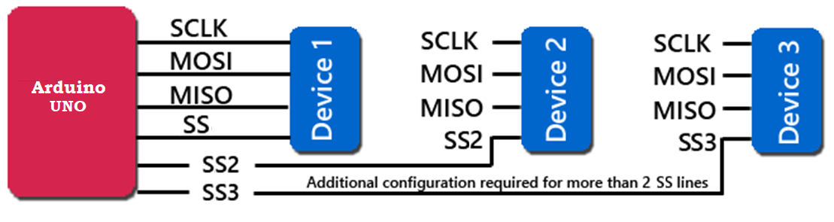
Serial Peripheral Interface(SPI)
PART-B
EXP No:12

Slide 20
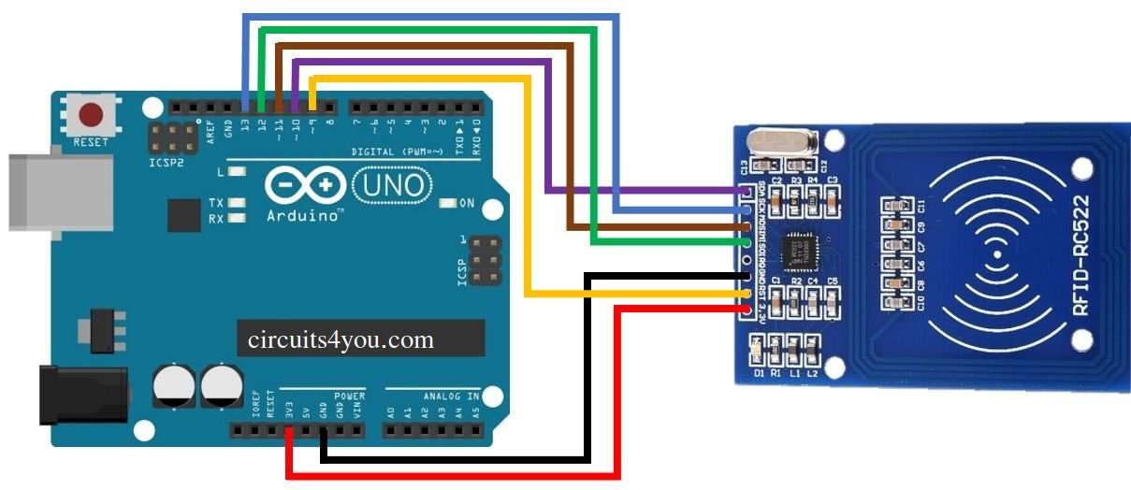
Arduino UNO & RFID Reader Connection
PART-B
EXP No:12

Slide 21
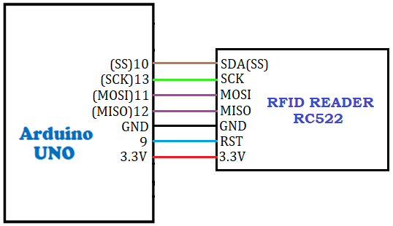
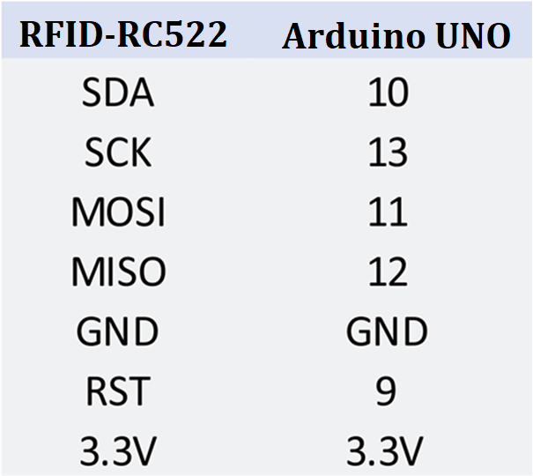
Arduino UNO & RFID Reader Connection
PART-B
EXP No:12
Hardware Block Diagram

Slide 22
FUNCTIONS
Digital I/O
Analog I/O
Communication
Time
Random Numbers
Characters
Advanced I/O
Math
Trigonometry
External Interrupts
And Many more……… depend on library files

Slide 23
Digital I/O
pinMode()
digitalWrite()
digitalRead()

Slide 24
Code 1-a
// WELCOME TO THE BACKBENCHERS YOUTUBE CHANNEL
// PLEASE SUBSCRIBE TO MY CHANNEL
// PRESS THE BELL ICON TO GET NOTIFIED MY LATEST VIDEO UPDATE
// THEANKS FOR WATCHING
//zaheer before going to access it u need to go to msc522 lib. and click on dumpinfo and change the sada(ss_pin) and rst pins and upload the codes;
// next u have to place the cards one after the other and note the keys
//copy one of the key of the card and past it in the code so that u can give access to only that card.
#include <SPI.h>
#include <MFRC522.h>
#include <Servo.h>
#define SS_PIN 10
#define RST_PIN 9
#define BUZZER 2 //buzzer pin
MFRC522 mfrc522(SS_PIN, RST_PIN); // Create MFRC522 instance.
Servo myServo; //define servo name

Slide 25
Code 1-b
return;
}
// Select one of the cards
if ( ! mfrc522.PICC_ReadCardSerial())
{
return;
}
//Show UID on serial monitor
Serial.print("UID tag :");
String content= "";
byte letter;
for (byte i = 0; i < mfrc522.uid.size; i++)
{
Serial.print(mfrc522.uid.uidByte[i] < 0x10 ? " 0" : " ");
Serial.print(mfrc522.uid.uidByte[i], HEX);
content.concat(String(mfrc522.uid.uidByte[i] < 0x10 ? " 0" : " "));
content.concat(String(mfrc522.uid.uidByte[i], HEX));
}
Serial.println();
void setup()
{
Serial.begin(9600); // Initiate a serial communication
SPI.begin(); // Initiate SPI bus
mfrc522.PCD_Init(); // Initiate MFRC522
myServo.attach(3); //servo pin
myServo.write(0); //servo start position
pinMode(BUZZER, OUTPUT);
noTone(BUZZER);
Serial.println("Put your card to the reader...");
Serial.println();
}
void loop()
{
// Look for new cards
if ( ! mfrc522.PICC_IsNewCardPresent())
{

Slide 26
Code 1-c
Serial.print("Message : ");
content.toUpperCase();
//
//
//
//("xxxxxxxxxxxxxxxxxxxx")= paste the card key hear after getting the ids of the card from files>>examples>>msc522>>dumpinfo>>card1+card2
if (content.substring(1) == "83 8D 1B 03") //change here the UID of the card/cards that you want to give access
{
Serial.println("Authorized access");
Serial.println();
delay(500);
tone(BUZZER, 500);
delay(300);
noTone(BUZZER);
myServo.write(180);
delay(5000);
myServo.write(0);
}
else {
Serial.println(" Access denied");
tone(BUZZER, 300);
delay(1000);
noTone(BUZZER);
}
}

